Slide 1
Home brew Buddipole
By KG5MCC

Slide 2
Home brew Buddipole By KG5MCC
                Disclaimer
I am not an expert by any means. I am an amateur radio operator that likes to build things. So why not build antennas? It keeps the cost down so anyone can afford to have a really good antenna.
I started my radio journey in March of 2016.
In August of 2016 I took the General exam and became a General operator.
In October of 2018 I took the Extra exam and became an Extra operator.
I have 3 kids - 14,13,and 7- and a Wife that puts up with my Radio time.

Slide 3
Home brew Buddipole By KG5MCC
BACKGROUND:
I started my journey by researching plans. The foundation of my Buddipole comes from the plans below (links included). As I started building and using these plans, I found that I needed to make some tweaks so that they would work for me. All of this information is included in this presentation.
THE PLANS: Bud designed this back in 2000
https://sites.google.com/site/w3ffhomepage/homebrew-buddipole-plans
www.buddipole.com

Slide 4
Home brew Buddipole By KG5MCC
Cost
The Buddipole is $199.00
The Buddipole deluxe is $399.00
The price to build your own…~ $110 plus tax
You may be able to get this cost down depending on what materials (like wire, tape, extension poles and heat shrink) you have at home from other projects.
Also, I have found that you can make some modifications to not need the wire whips that are listed here (I will discuss later in the presentation).

Slide 5
Home brew Buddipole By KG5MCC
Parts needed and approximate cost:
                18 Awg Speaker wire - 20’ ~$16 / 100’
½” x 4” Sprinkler riser pipe – x2 ~ $0.58 ea
½” x 6” Sprinkler riser pipe - x2 ~ $0.78 ea
½” Female adapters – x6 ~ $0.75 ea
½” Female couplers - x4 ~ $0.97 ea
½” x 24” Sprinkler riser pipe - x2 ~ $2.18 ea
½” x 18” Sprinkler riser pipe - x1 ~ $1.68 ea
½” street elbows x2 ~$1.14 ea
½” plug x2 ~$1.16 ea
½” T threaded on all sides – x1 ~ $2.00 ea
½” PVC cross – x1 ~ $1.50 ea
6’ lightweight telescopic whips – x2 ~ $11.00 ea
Connectors – x10 sets ~ $ 1.00 /set
  1 male and 1 female = set
1 roll of black electrical tape ~ $ 2.00 ea
8 to 10 ft of coax cable RG8 or RG58 ~ $ 17.00
11’to 12’ telescope pole –x1 ~ $35.00 ea
Heat shrink - 6” ~ $ 2.00
  you might have a spare piece from another project.

Slide 6
Home brew Buddipole By KG5MCC
Tools needed:
1/8 “ drill bit Drill - corded or cordless
Soldering iron Solder
Wire cutters Wire crimpers
Needle-nose pliers PVC cutters or hacksaw
Tape measure Heat gun or lighter
PVC primer and glue

Slide 7
Home brew Buddipole By KG5MCC
I followed the instructions that are on the website
The materials (CPVC) were press fitted together.
When I tested the antenna it was falling apart, so I modified the instructions to make what I call “version 3.0”.

Slide 8
Home brew Buddipole By KG5MCC
The antenna is a dipole that is constructed out of sprinkler riser pipe and plastic EMT fittings.
  There are telescopic whips at the ends of each side of the dipole, and these whips are adjusted to bring the antenna into resonance on each HF band.
The longest elements are on 10 and 12 meters, where the dipole is actually a full half wave.
On the lower bands, coils are used to shorten the antenna.

Slide 9
Home brew Buddipole By KG5MCC
Building the Buddipole:
Start with the coils.
Use the ½” riser pipes – 4” and 6” lengths
Measure 7/8” from both sides of the pipe and mark the spot.
  The marks should be in line with each other on each pipe.
Do this for both pieces of pipe.

Slide 10
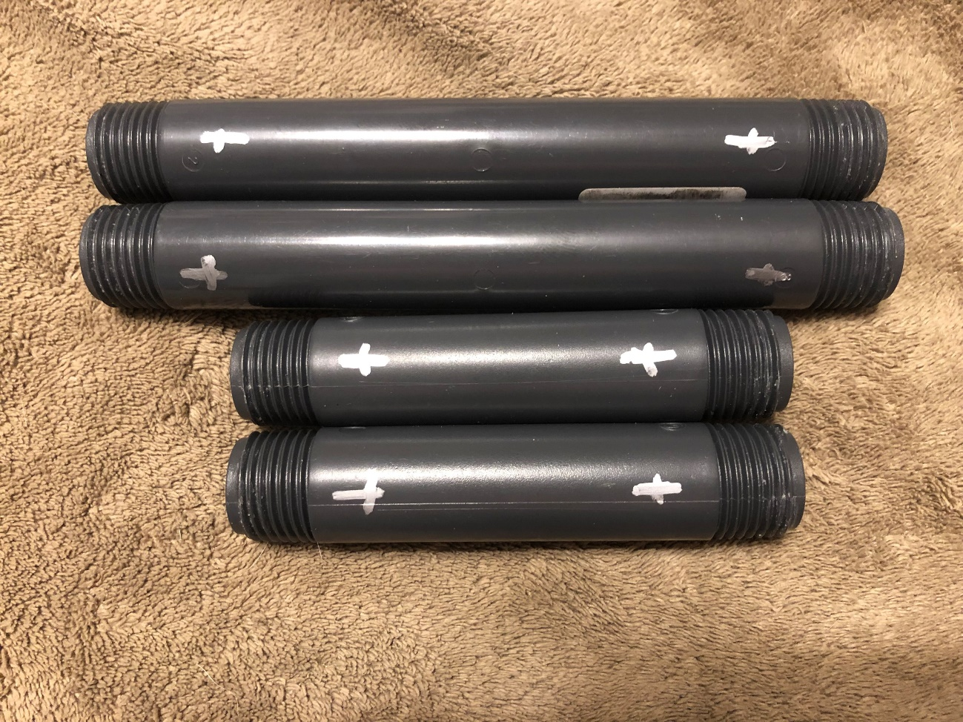
Home brew Buddipole By KG5MCC

Slide 11
Home brew Buddipole By KG5MCC
Building the coils:
Take the pipes – both the 4”and 6” sections
Use the 1/8” drill bit to drill a hole all the way through the pipe.
Do this for all 4 pipes.

Slide 12
Home brew Buddipole By KG5MCC
Building the coils:
For the 4” pipes
These will be used for the 15 and 17 Meter coils
Take the speaker wire and measure out 72” of wire
Take and split the wire into 2 wires
  One side of wire will be used for one coil and the other side will be used for the other coil.

Slide 13
Home brew Buddipole ByKG5MCC
Building the coils:
This will be used for the 6”pipes
The 6” pipes will be the 20 meter coils
Take the speaker wire and measure out 128”
Take and split the wire into 2 wires
  One side of wire will be used for one coil and the other side will be used for the other coil

Slide 14
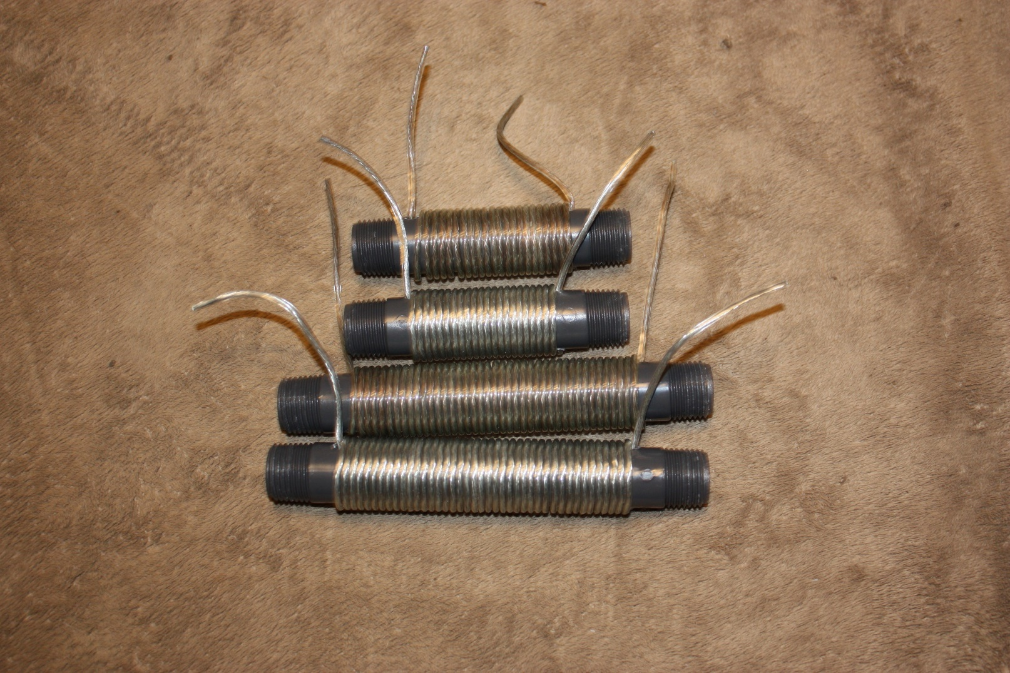
Home brew Buddipole By KG5MCC
Coils
4” Long ½” riser pipe with 22 turns
6” Long x ½” riser pipe with 41 turns

Slide 15
Home brew Buddipole By KG5MCC
Building the extension arms:
Now get the 24” riser pipes
Measure out 10 ¼” from the male pipe threads on both sides
Cut the pipe on both ends
Save the cut off pieces to use with the center section
Glue the female pipe adapter to the pipe to make the extension arm
Do this for 4 pieces

Slide 16
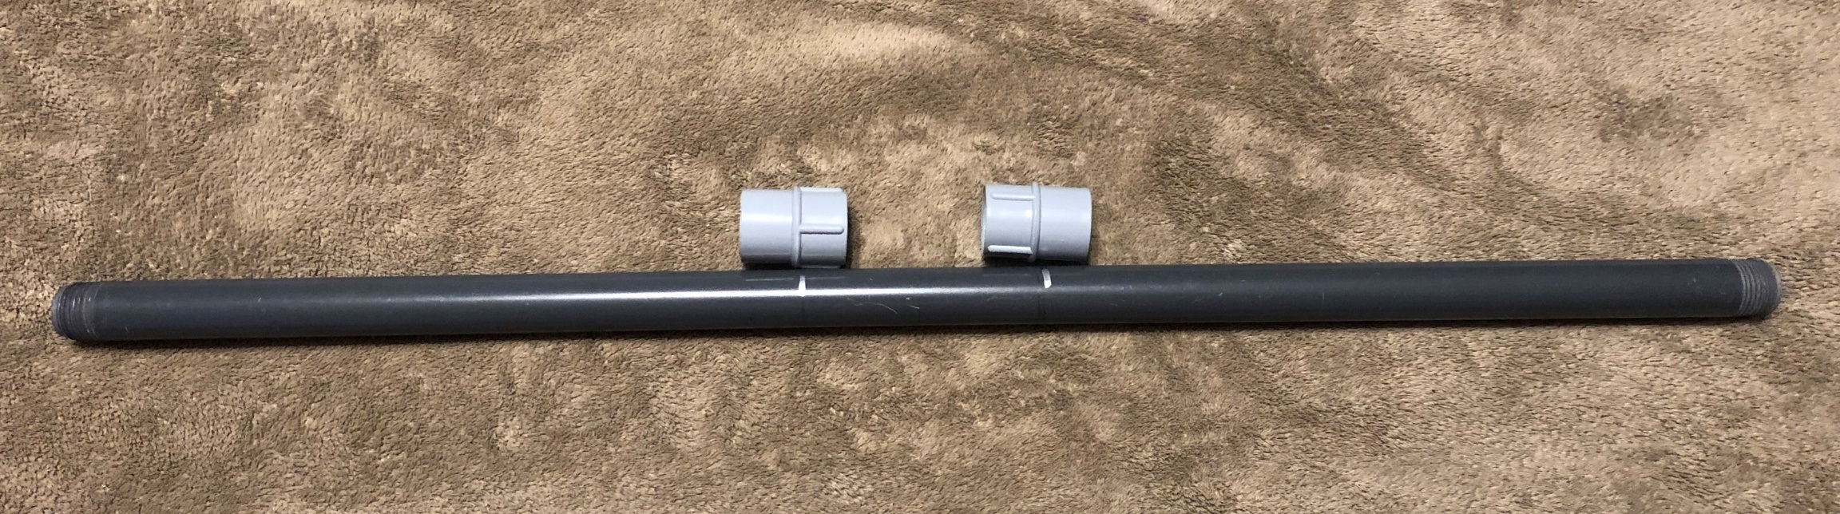
Home brew Buddipole By KG5MCC
Extension Arms:

Slide 17
Home brew Buddipole By KG5MCC
    Telescopic Sections:
Use the 18” riser pipe.
Measure out the pipe to half way and cut the pipe to make two 9” pipes – each with threads on one end.
Measure 1” from the threaded end and drill an 1/8” hole in the pipe
  Only drill through one side of the pipe.
Wind electrical tape around the base of the metal antenna
You want to make a snug fit between the antenna about the inner diameter of the PVC pipe.
Leave about 2 to 3 inches of wire sticking out of the pipe to make an electrical connection.

Slide 18
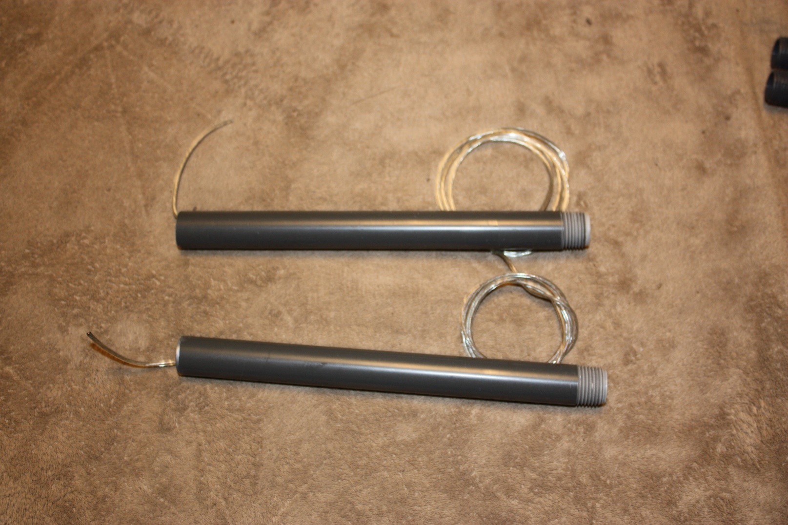
Home brew Buddipole By KG5MCC
Telescopic sections

Slide 19
Home brew Buddipole By KG5MCC
Coax assembly
Make a coil
It needs to have a 4” diameter
Make 7 turns and then secure with black tape.
Strip back 1” on one end of the coax cable
  The center of the coax will be the red side.
  The shield will be the black side.
One the opposite end, install the connector of your choice.
  PL259, BNC, or N-type connector

Slide 20
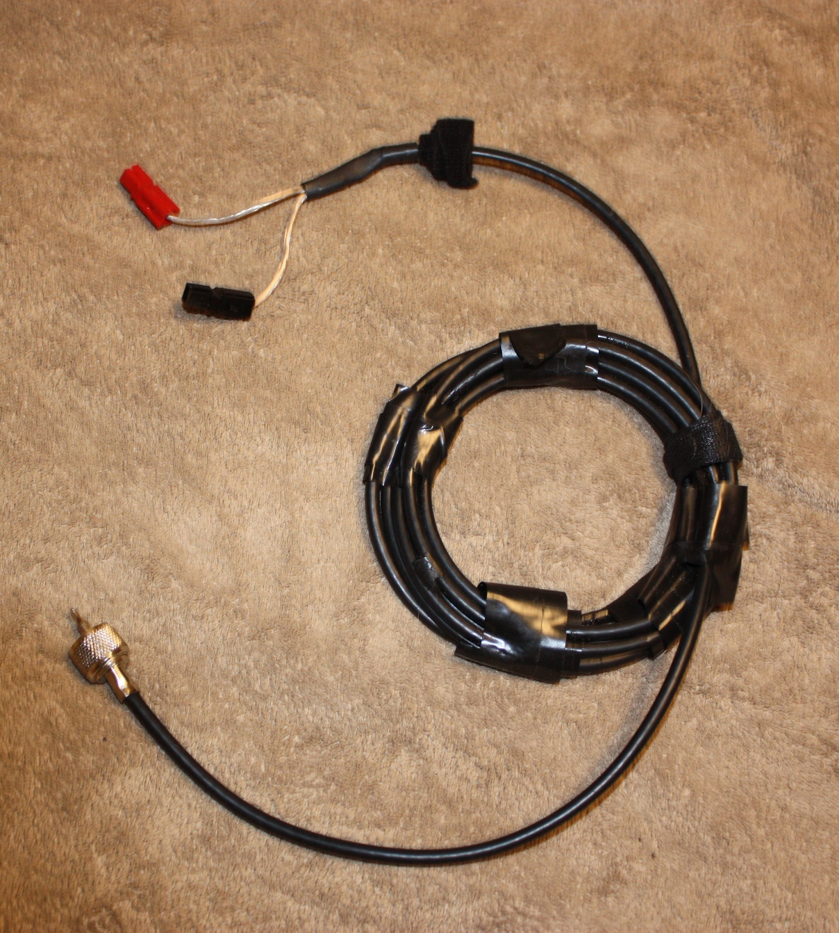
Home brew Buddipole By KG5MCC
Coax Assembly
Air Core Choke

Slide 21
Home brew Buddipole By KG5MCC
Center section assembly:
Parts needed:
PVC cross
½” female adapters – X 4
The cut off pieces from 24”sections – x4
  Take the cut off pieces and cut them in half
  These new pieces should be 1½” long each – x8

Slide 22
Home brew Buddipole By KG5MCC
Center section assembly:
Place the cutoff pieces with a female adapter
Insert the pieces into the cross section for 4 sides

Slide 23
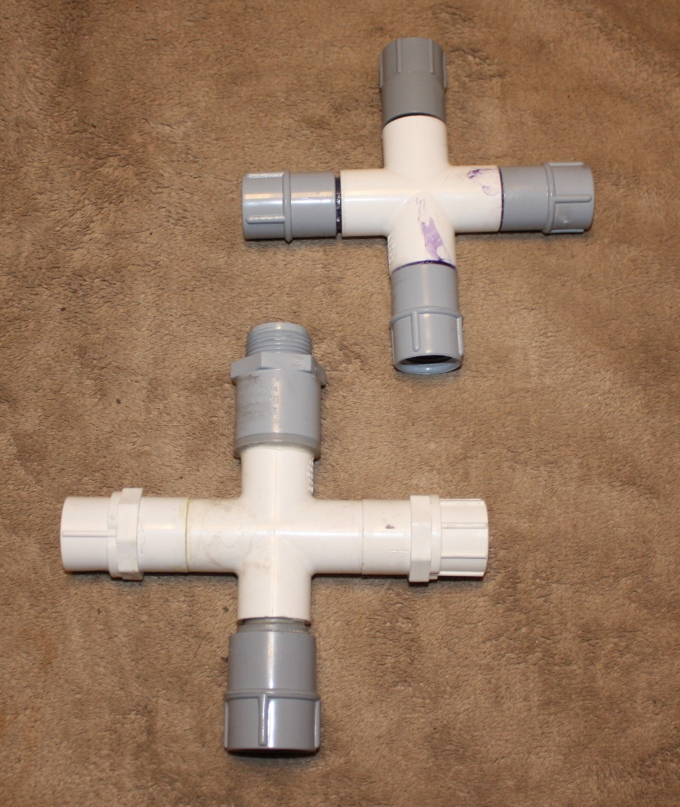
Home brew Buddipole By KG5MCC
Center Section Assembly

Slide 24
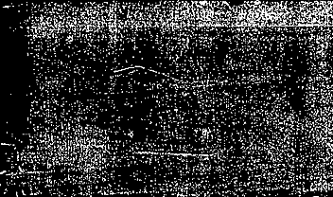
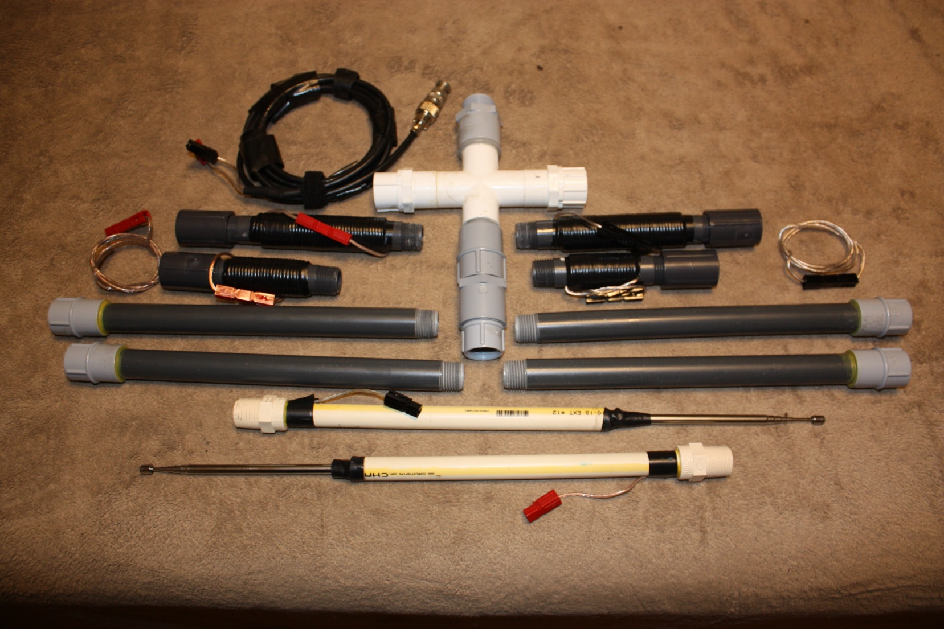

Homebrew Buddipole By KG5MCC
Parts Assembled

Slide 25
Home brew Buddipole By KG5MCC
Assembling the Buddipole:
Use the cross that we assembled with the female adapters
Use two extension arms – one for each side
Place one coil per arm – one for each side 4” or 6” long coils
Insert the telescopic antenna in each side to finish out the antenna
Use two 28” pieces of wire to make the connections for the arms to the 4” Diameter coax choke

Slide 26
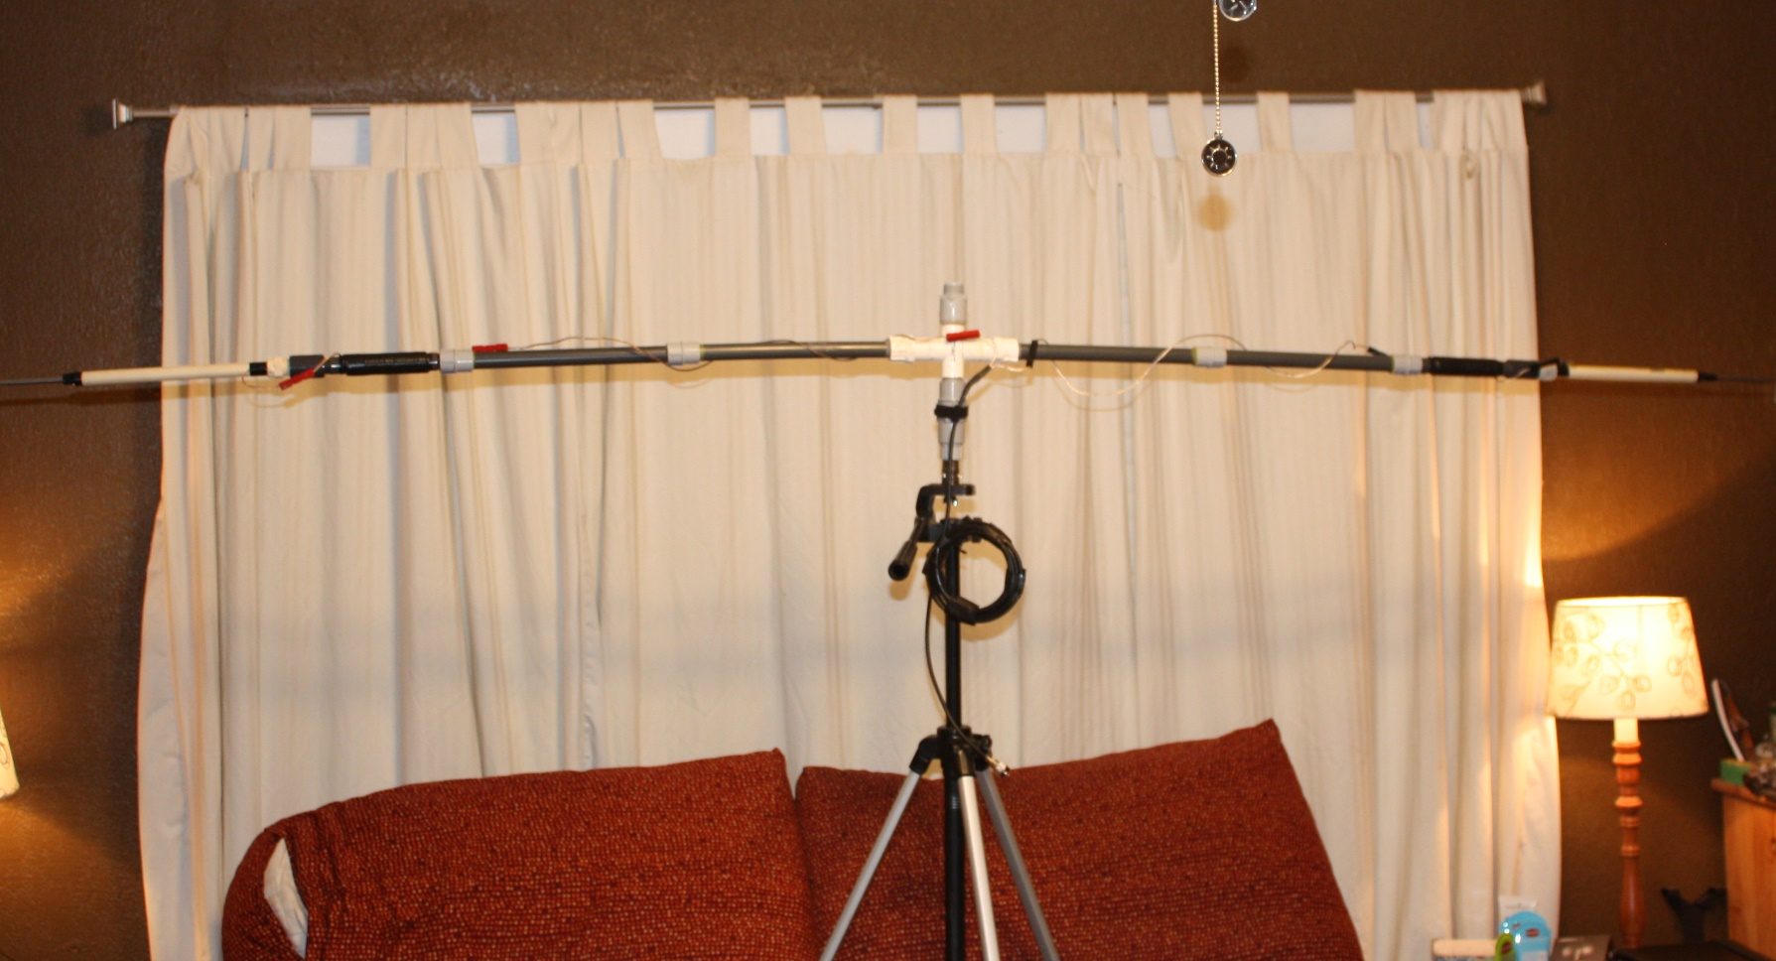
Home brew Buddipole By KG5MCC
Assembly of Buddipole
Tripod is Optional

Slide 27
Home brew buddipole By KG5MCC
Coil information:
No coils are needed for 6, 10, and 12 Meters
One 4”coil is used for 15 and 17 Meters
One 6”coil is used for 20 ,30, and 40 meters
2 Meters vertical has also worked

Slide 28
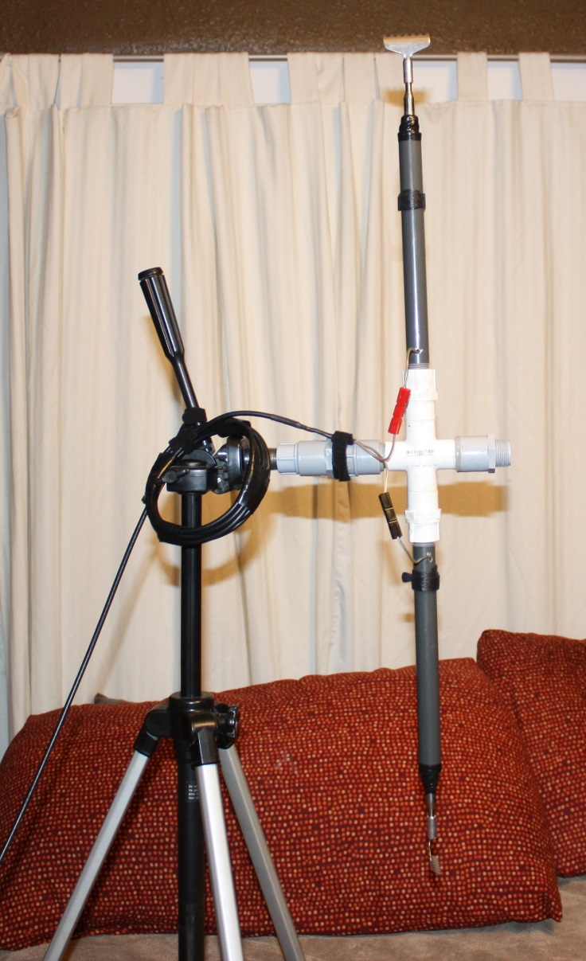
Homebrew Buddipole By KG5MCC
2 Meter Vertical

Slide 29
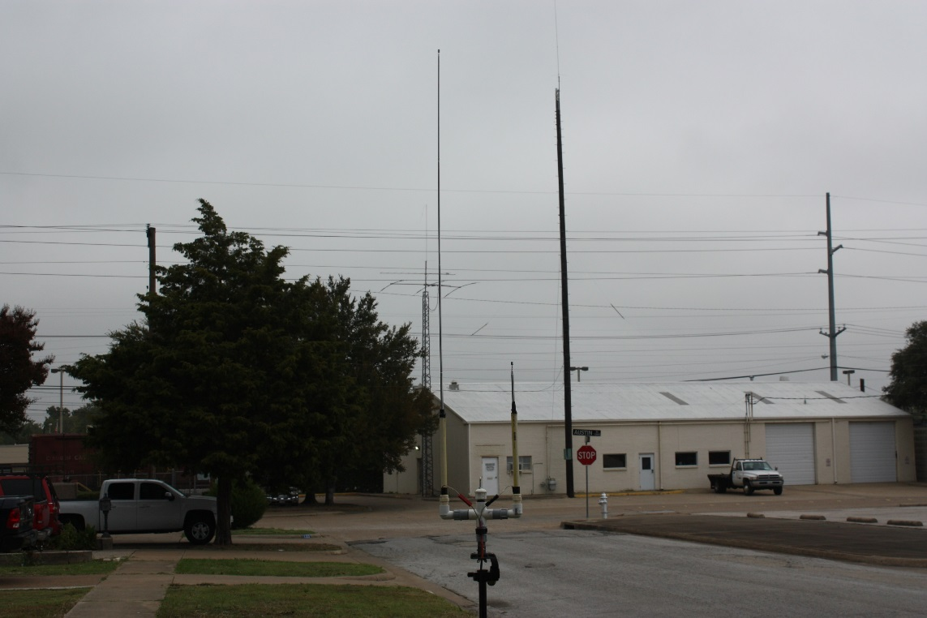
Home brew Buddipole By KG5MCC
2 Meter J pole
70 cm J pole
2 ½ Street elbows and center section
Red side is 3 sections
Black side is no sections
2 Meter swr is 1.0
70 cm swr is 1.3

Slide 30
Home brew Buddipole By KG5MCC
Tuning Tips:
6 Meters - whips with 4.5 sections extended on both sides
10 Meters - whips with 5 sections extended on both sides
12 Meters - whips have all sections extended on both sides
15 Meters - extension arms with 4” coils and whips on both sides
  2 sections plus 2” on red side and 3 sections on black side
17 Meters - extension arms with 4” coils and whips on both sides
  3.5 sections on red side and 5 sections on black side

Slide 31
Home brew Buddipole By KG5MCC
Tuning tips:
20 Meters - extension arms with 6” coils and whips
  3 sections plus 4” on red side and 5 sections on Black side
30 Meters - extension arms and 6” coils and whips
  fully extended on both red and black sides
40 Meters - extension arms and 6” coils and whips
  fully extended on both red and black sides

Slide 32
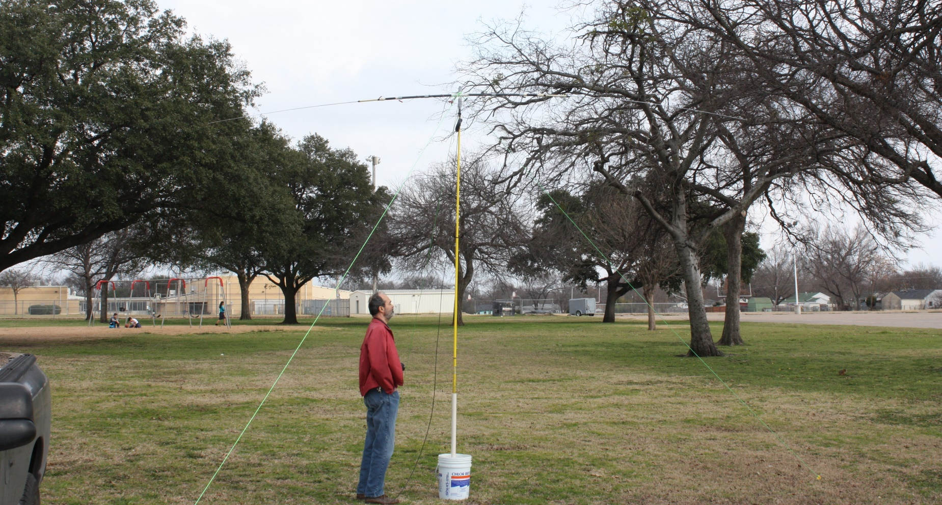
Home brew Buddipole By KG5MCC

Slide 33
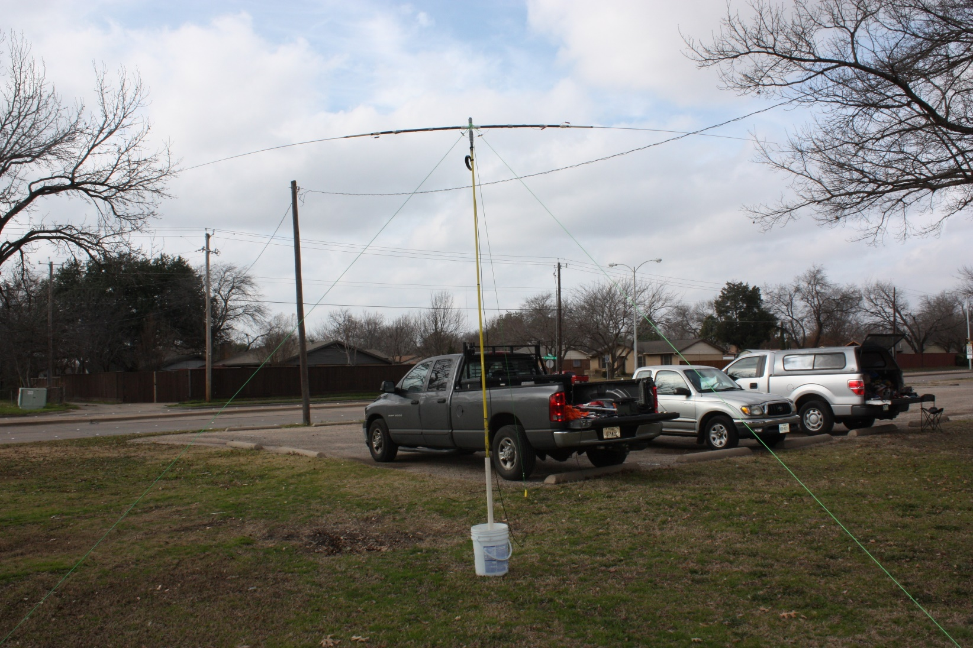
Home brew Buddipole By KG5MCC

Slide 34
Home brew Buddipole By KG5MCC
Alternative Whips:
4 Extension poles, 2 CPVC pieces - 28” long and 72” wire.
4 Extension poles, 2 smaller antennas, and wire for connections

Slide 35
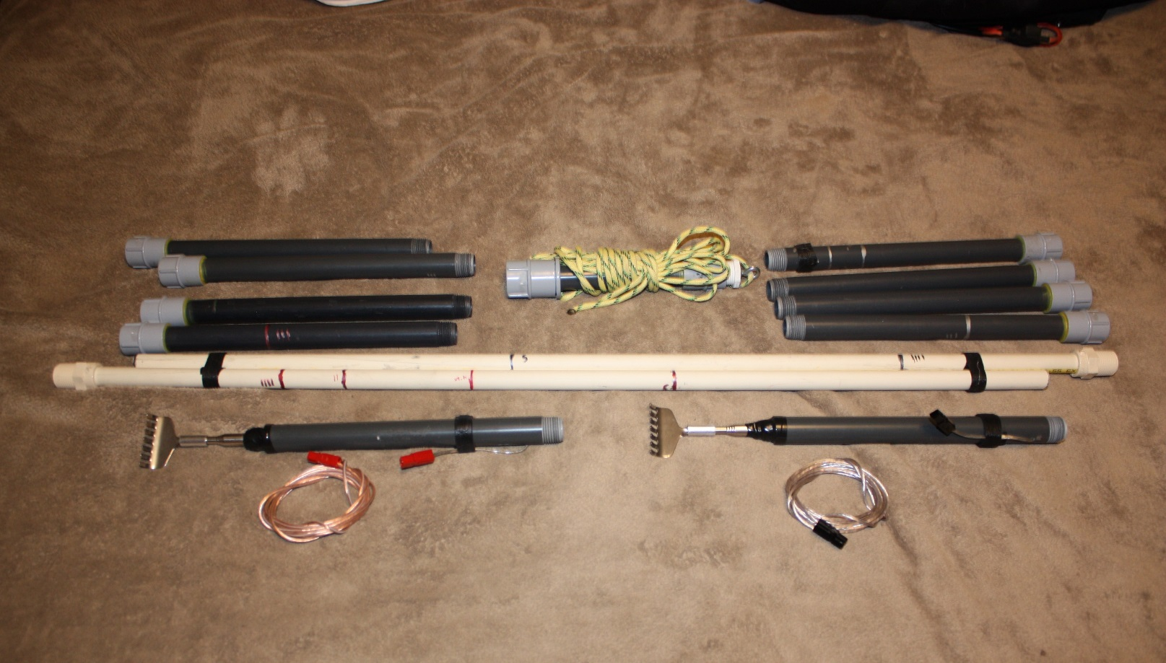
Homebrew Buddipole By KG5MCC
Alternative whips

Slide 36
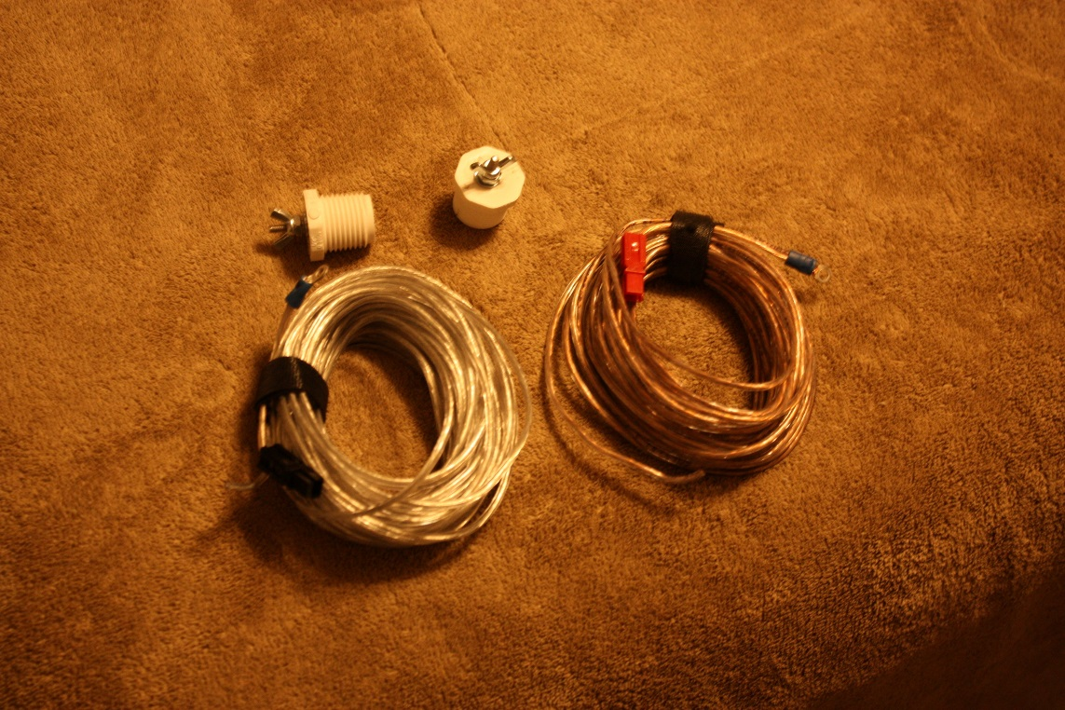
Home Brew Buddipole By KG5MCC
Bonus 80 meters NVIS
½’ plugs x 2
6/32 x ¾’ machine screw
2 6/32 wing nuts
18 gu speaker wire 29’
Split the wire into 2 halfs
Red side is 28’
Black side is 29’
Center section is at 9’
Red and black are at 2’

Slide 37
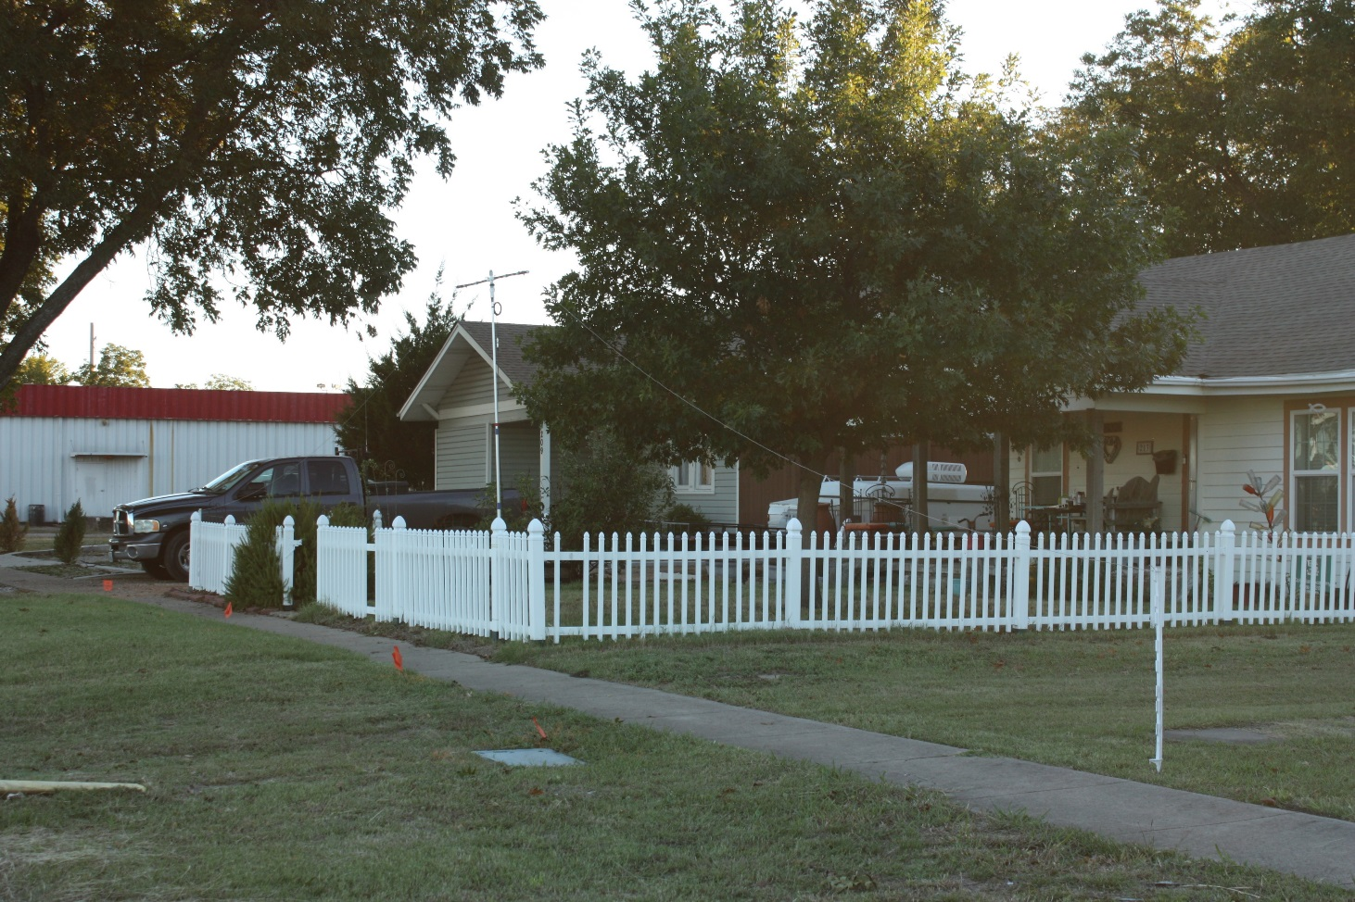
Home brew buddipole by KG5MCC

Slide 38
The End
mjconstrux@yahoo.com

